Slide 1
Capstone Project-1 Global Terrorism Analysis
Rishi Gupta
Data Science Trainee,
Almabettter.

Slide 2
Introduction
The Global Terrorism Database (GTD) is an open-source database including information on terrorist attacks around the world from 1970 through 2017. The GTD includes systematic data on domestic as well as international terrorist incidents that have occurred during this time period and now includes more than 180,000 attacks. The database is maintained by researchers at the National Consortium for the Study of Terrorism and Responses to Terrorism (START), headquartered at the University of Maryland.
We have to explore and analyze the data to discover key findings pertaining to terrorist activities.

Slide 3
Problem Statement
The Global Terrorism Database (GTD) documents more than 200,000 international and domestic terrorist attacks that occurred worldwide since 1970. An action must also be carried out for political, economic, religious, or social purposes to count as terrorism. The GTD defined as: "The unlawful use of force or violence against persons or property to intimidate or coerce a Government, the civilian population, or any segment thereof, in furtherance of political or social objectives." The GTD includes more than 83,000 bombings . It also includes more than 18000 assassinations and more than 11000 kidnappings.
We have to find
year Vs Number of terrorist attack?
which top 5 countries has highest terrorist attacks?
which 5 cities has hightest terrorist attacks?
which attack types mostly used?
which regions has hightest terrorist attacks?
which weapon is mostly used by terrorist?
find motive behind the terrorist attacks?
who are main targets of attacks?
which gropes are mostly active terrorist attacks?

Slide 4
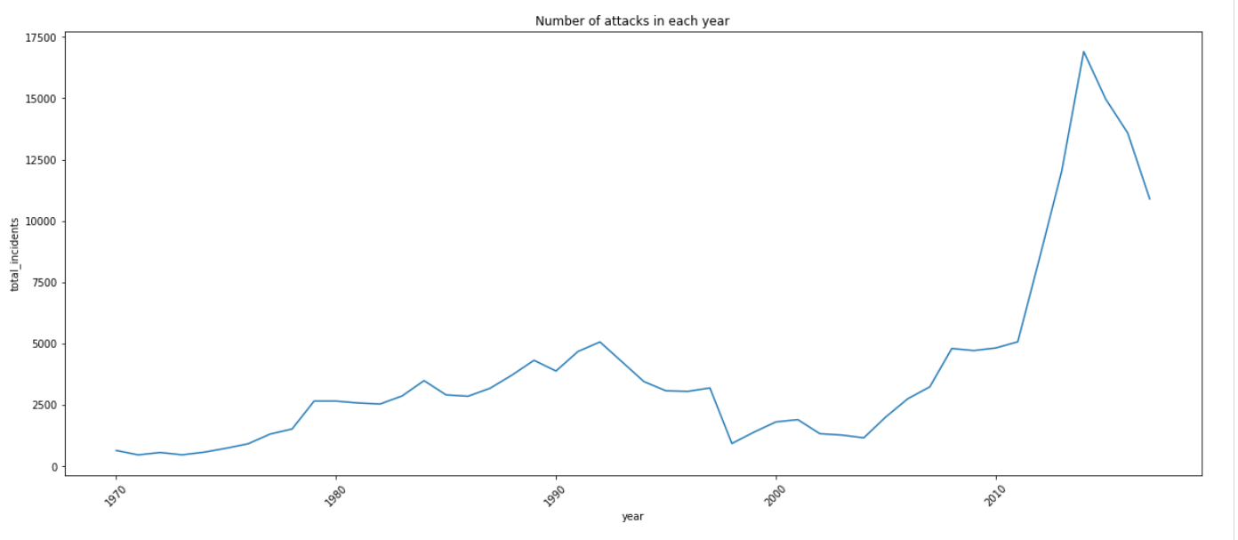
Exploratory Data Analysis
Number of attacks each year-

Slide 5
The terrorist attacks gradual increase in 2004.
The highest peak of attacks in 2014.
After 2014 attacks decreases.

Slide 6
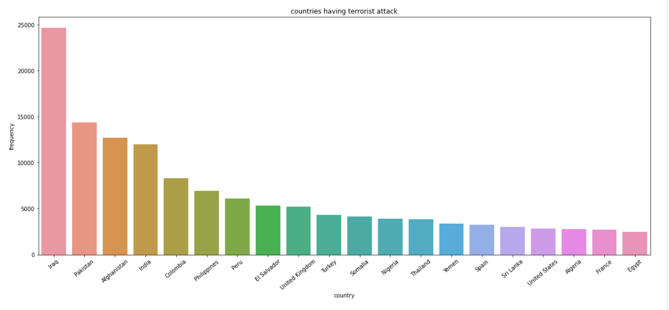
Countries with highest terror attacks-
Iraq, Pakistan, Afghanistan, India and Colombia these countries has highest terrorist attacks.

Slide 7
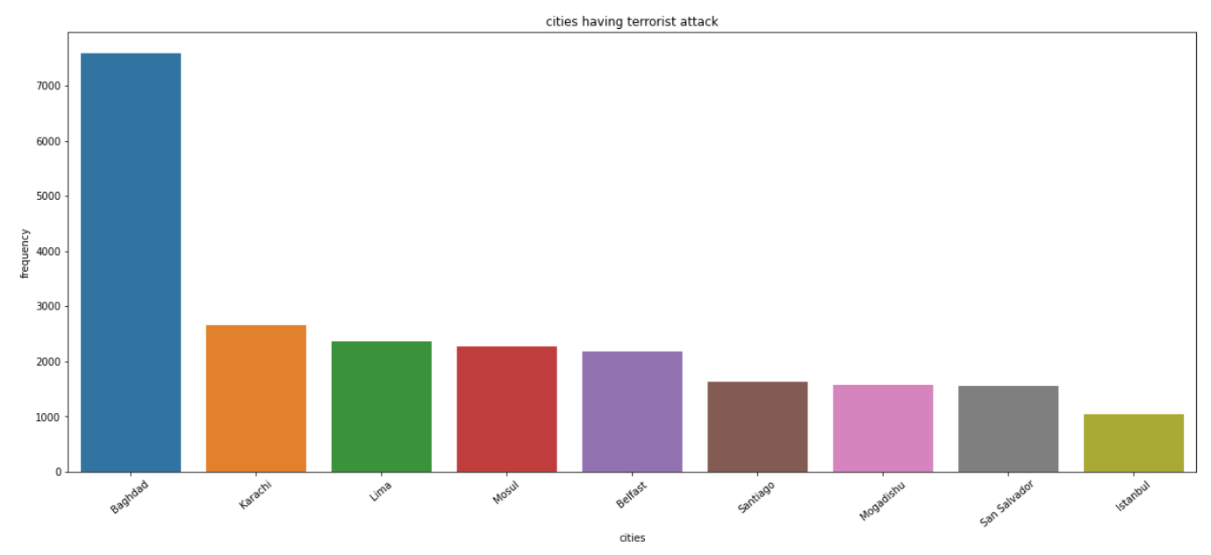
Cities with highest terror attacks-
Baghdad, Karachi, Lima, Mosul, Belfast this cities has highest terrorist attack.

Slide 8
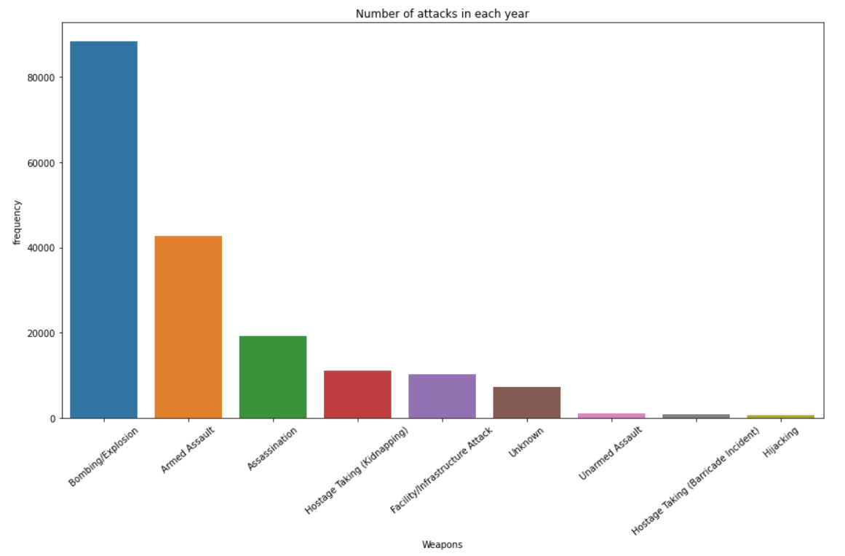
Type of attack-
Bombing/Explosion, Armed Assault these attack types are mostly used.

Slide 9
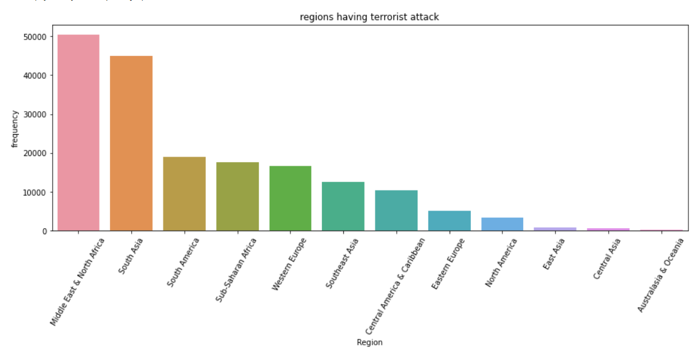
Regions with highest terror attacks-
Middle east & North Africa is the region with highest terror aattack followed by South Asia and South America.

Slide 10
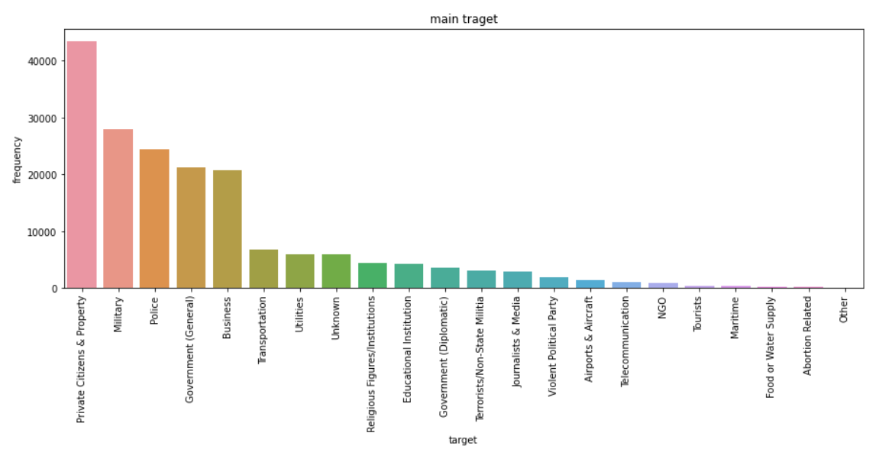
Main target-
Private Citizens & Property, Military, Police, Government (General), Business these are majour targets for terrorist groups.

Slide 11
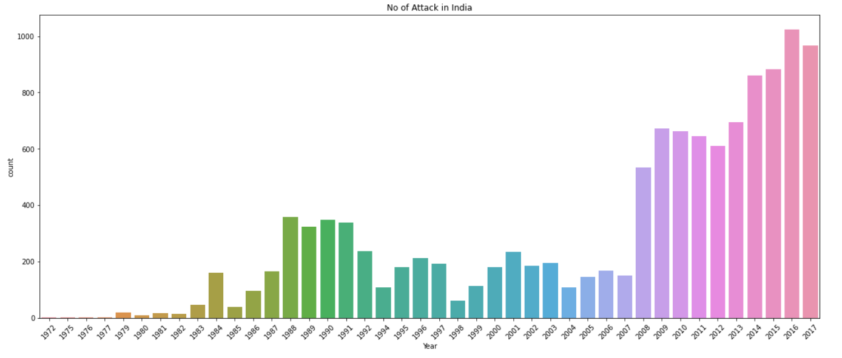
Number of attacks in India-
After 2007 attacks are gradually increases.

Slide 12
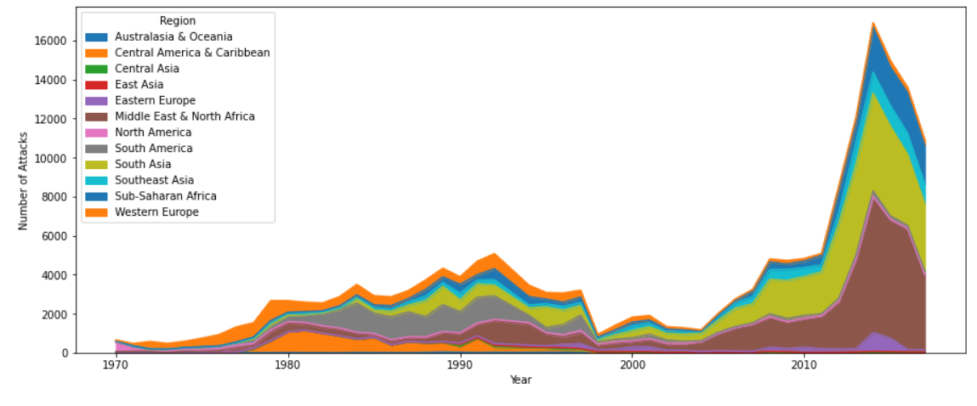
Terror activities in each year w.r.t region
From barplot and cross tab we can see that Middle East & North Africa, South Africa are highest terrorist attack region.
Australia and Oceania and Central America has maximum attack after 2004.
There have been less terrorist attack in East Asia and north America.

Slide 13
Conclusion
The time interval between 1979 to 1997, few terrorist attacks but after 2005 attacks are increased year by year.
Iraq (24636), Pakistan (14368), Afghanistan (12731), India (11960) and Colombia (8306) these countries has hightest terrorist attacks.
Baghdad, Karachi, Lima, Mosul, Belfast these cities has highest attacks in world.

